Slide 1

Which customers are less or more loyal?
Ezgi Nazman
An international customer churn bank data

Slide 2

Identify potential churn factors!
Credit Score?
Country?
Gender?
Age group?
Tenure?
Balance?
Number of products?
Has credit card?
Is active member?
Estimated Salary?

Slide 3
Methodology
Specify potential factors which affect on churn decision
Determine potential customers who tend to churn
Identify loyalty degree of the customers

Slide 4
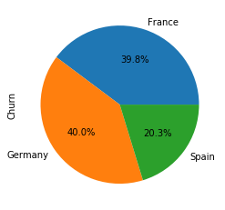
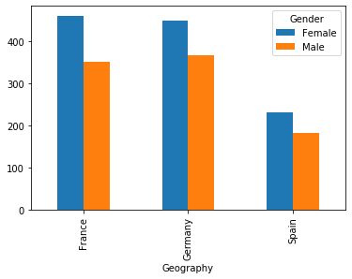
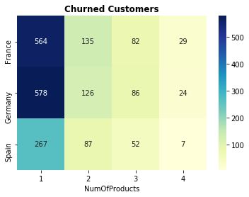
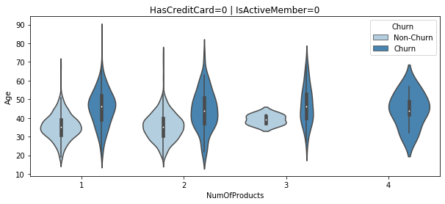
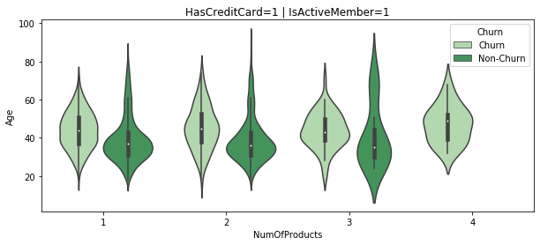
Potential churn factors?

Slide 5
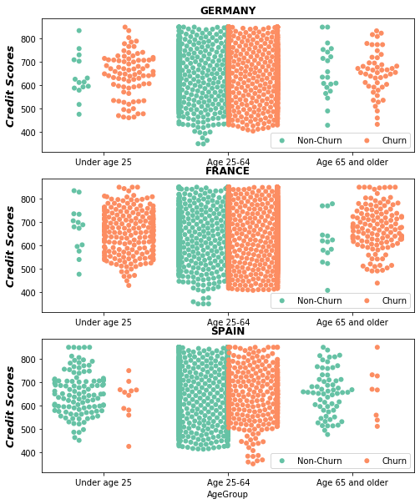
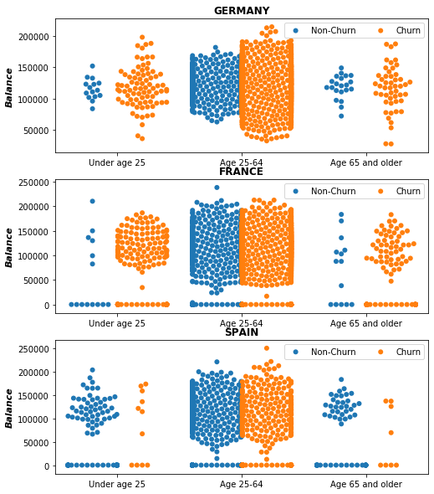
Potential churners?

Slide 6
Less Loyal Customers
More Loyal Customers
Germany & France
Female
NumOfProduct < 2
Age 25-64
Has Credit Card
Germany & France
Student & retired
Spain
Male
NumOfProduct >= 2
Active member
Spain
Student & retired
Conclusion

Slide 7
Future work
How are the negative, zero and positive balance effect?
Is churn decision related with product types?
Churn prediction using Machine Learning algorithms?

Slide 8


